Slide 1
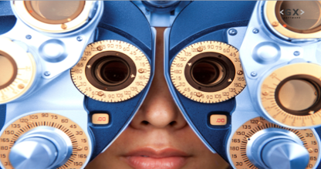
MBA analysis Electronidex
Natasja Fortuin, Oct. 2019

Slide 2
Summary
Are there any interesting patterns & associations between customer’s transactions and the item(s) they’ve purchased that can help decide whether to take over Electronidex.
And what about the Apple laptop.
Purchasing patterns
Discover associations between products for recommender system
Give insight to the board of Electronidex’s customer buying patterns to decide about acquisition of Electronidex.

Slide 3
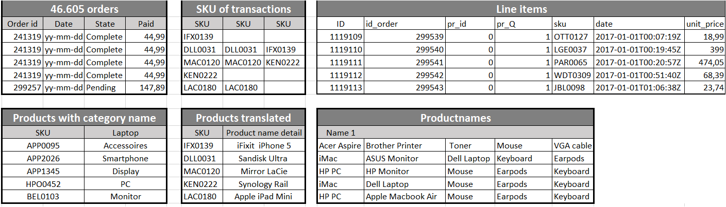
Overview of data supplied
30 days worth of Electronidex’s online transactions
file containing all the electronics that Electronidex currently sells
14,5 months of all transactions of more than 2 products purchased
Online order details
Items bought per order
Products by SKU with price paid (duplicated order numbers)
Items by SKU categorized
SKU with product name
Names of products per transaction

Slide 4
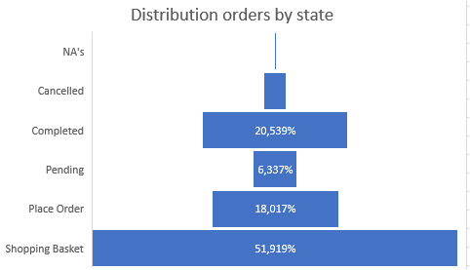
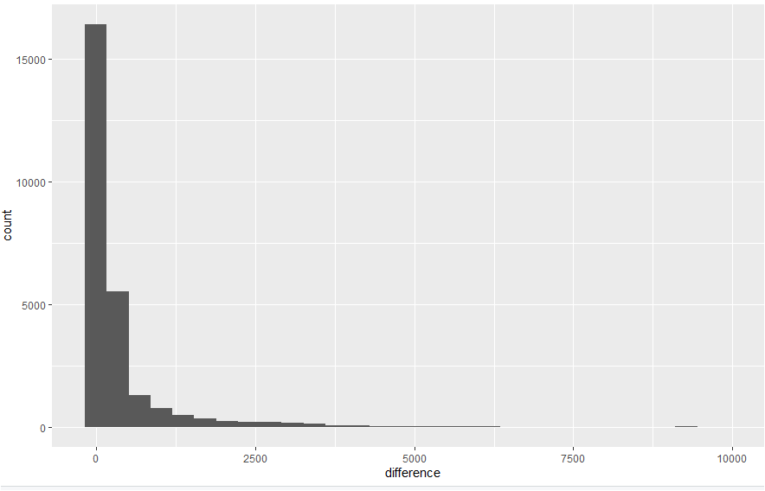
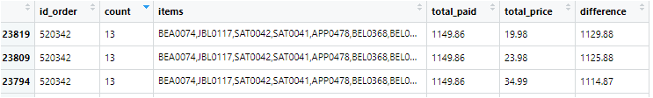

Data quality
For the analysis online (completed) orders (21%), transaction data
& product detail information are used to create an overview of
unique orders with more than 2 items purchased together.
A price check was done between what was paid online and what the price
would have been based on unit price information and amount of items bought.
It needs to be noted that for a moderate part of the data a price difference
between the amount paid and what should be paid is found. Sometimes
substantial amounts, sometimes almost insignificant. This needs to
be investigated further.

Slide 5
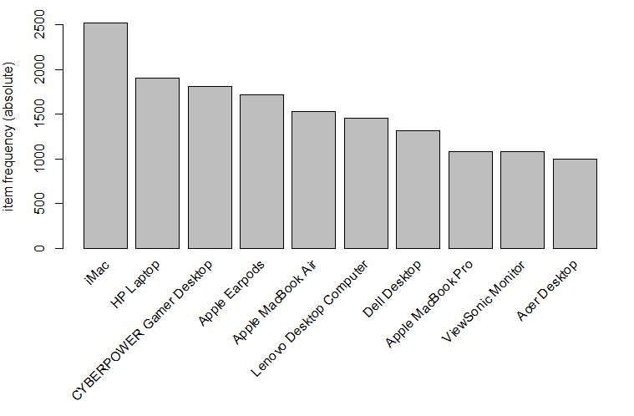
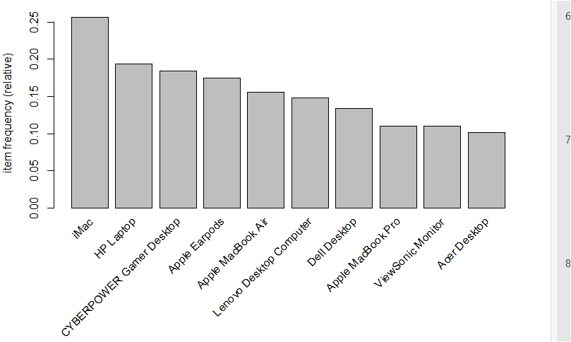
Apple iMac and HP Laptop in Top 10
Absolute
Relative
Item Frequency Top 10 products

Slide 6
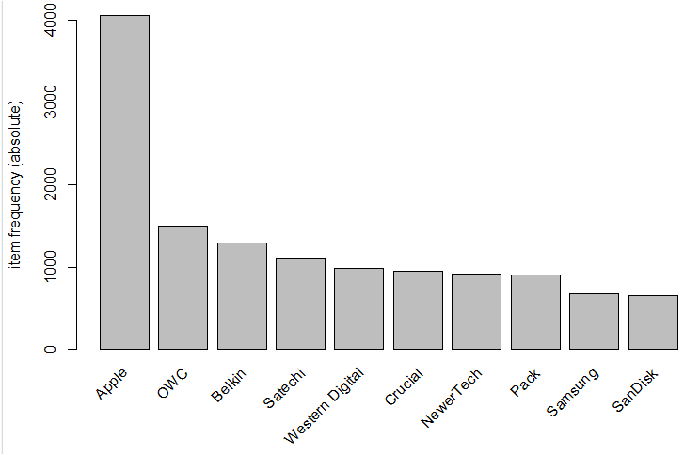
Apple is king
Top 10 by brand

Slide 7
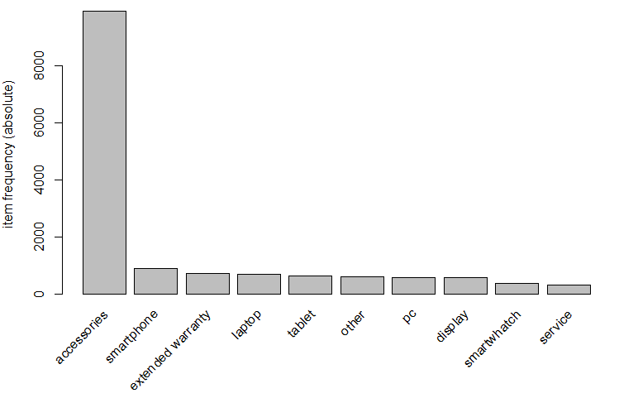
Accessories is dominant in sales
Top 10 product categories
Top 10 ItemFreqPlot of transactions by category

Slide 8
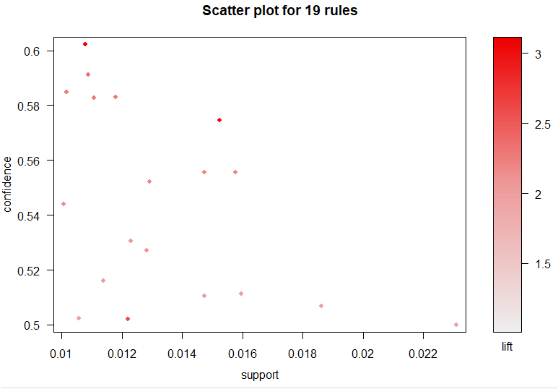
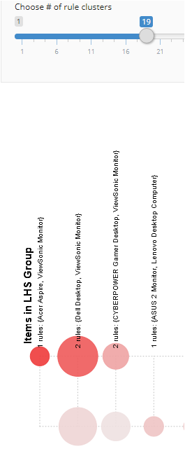
Scatterplot 19 rules
The higher the frequency of products bought together (support), it becomes more unlikely that this combination of products gets purchased (confidence).
Market Basket analysis
Support 0.01, Confidence 0.50 gives 19 possible combinations

Slide 9
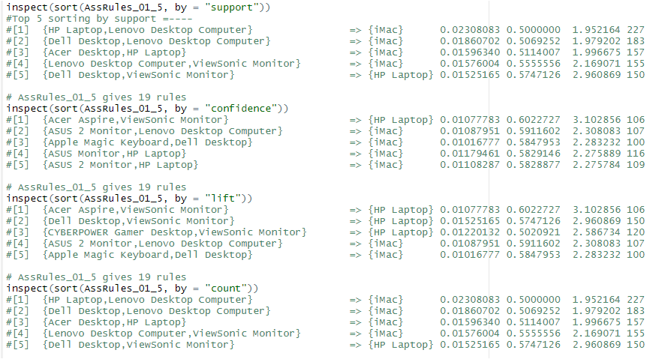
Top 5 sorted by importance of measurement
iMac and HP Laptop are likely to be considered for purchase in general.
Market Basket analysis
Support 0.01, Confidence 0.50 gives 19 possible combinations

Slide 10
What about the Apple laptop
iMac and HP Laptop are likely to be considered for purchase in general.
lhs rhs support confidence lift count
[1] {Apple MacBook Air,HP Laptop} => {iMac} 0.01026945 0.4261603 1.663869 101
[2] {Apple MacBook Air,iMac} => {HP Laptop} 0.01026945 0.3607143 1.858368 101
Market Basket analysis
Support 0.01, Confidence 0.50 gives 19 possible combinations

Slide 11
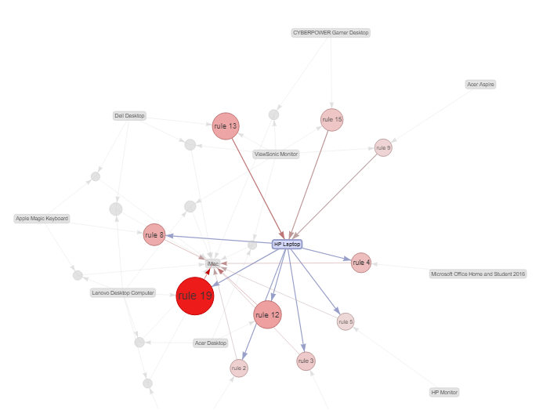
Rules connected to HP Laptop by importance
iMac and HP Laptop are likely to be considered for purchase in general.
Support = % transaction show Anti-virus software is bought with purchase of a Computer
50% of customers who purchase Anti-virus software is bought with purchase of a Computer
Market Basket analysis
Support 0.01, Confidence 0.50 gives 19 possible combinations

Slide 12
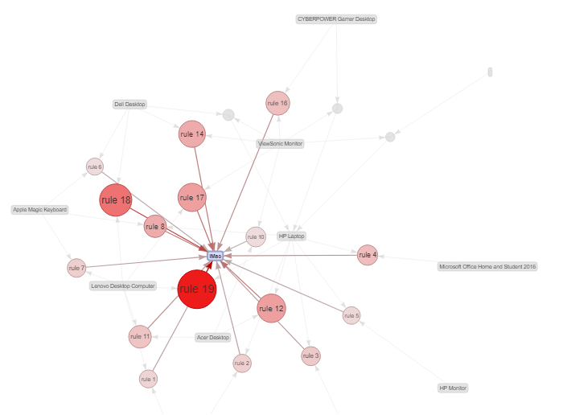
Rules connected to iMac by importance
iMac and HP Laptop are likely to be considered for purchase in general.
Market Basket analysis
Support 0.01, Confidence 0.50 gives 19 possible combinations

Slide 13
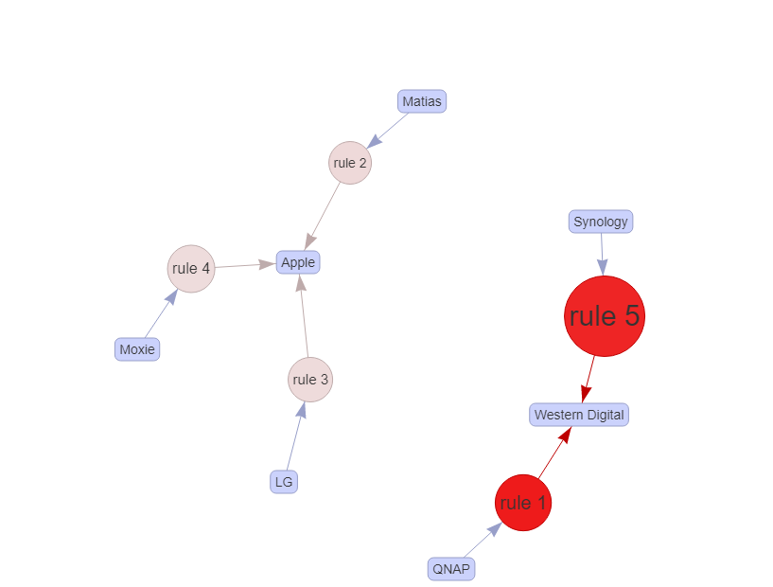
Rules based on brand name analysis
89% of the customers who bought QNAP also bought ‘Western Digital’ products like hard-drive, my book, my cloud server, my passport. All are accessoires that can be combined with a Mac.
86% of the customers who bought Synology Digital also bought
‘Western Digital’. Both are accessories for Mac , PC’s, and camera’s.
lhs rhs support confidence lift count
[1] {QNAP} => {Western Digital} 0.03003635 0.8895184 9.421505 314
[2] {Matias} => {Apple} 0.02544481 0.7687861 1.983927 266
[3] {LG} => {Apple} 0.02611441 0.7459016 1.924872 273
[4] {Moxie} => {Apple} 0.02707098 0.7201018 1.858293 283
[5] {Synology} => {Western Digital} 0.03826287 0.8639309 9.150490 400
Market Basket analysis
Support 0.025, Confidence 0.70 gives 5 rules

Slide 14
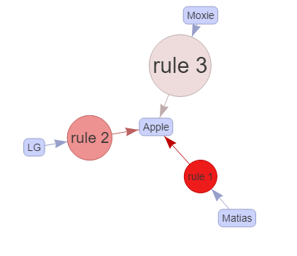
RHS
89% of the customers who bought QNAP also bought ‘Western Digital’ products like hard-drive, my book, my cloud server, my passport. All are accessories that can be combined with a Mac.
86% of the customers who bought Synology Digital also bought
‘Western Digital’. Both are accessories for Mac , PC’s, and camera’s.
What about products that will result in buying an Apple product (2,3,4)
Customers buying Matias, LG, Moxie are likely to also buy an Apple product.
lhs rhs support confidence lift count
[1] {QNAP} => {Western Digital} 0.03003635 0.8895184 9.421505 314
[2] {Matias} => {Apple} 0.02544481 0.7687861 1.983927 266
[3] {LG} => {Apple} 0.02611441 0.7459016 1.924872 273
[4] {Moxie} => {Apple} 0.02707098 0.7201018 1.858293 283
[5] {Synology} => {Western Digital} 0.03826287 0.8639309 9.150490 400
Market Basket analysis
Support 0.025, Confidence 0.70 gives 5 rules

